Slide 1
ETUC
RETHINKING SUSTAINABLE GROWTH FOR DEMOCRACY, SECURITY,
AND QUALITY JOBS
Session 3:
A new economic governance for the EU. What about social?
“Much ado about nothing”
by Stefano Fassina
Lecce (Italy) and Zoom platform, 7th September 2023
European Semester Project

Slide 2
The reform of the economic governance
Actually, they are changes to the preventive arm and the corrective arm of the EU fiscal framework (i.e. replacement of Reg 1466/97 and amendments to Reg 1467/97 as amended by the «Six pack» in 2011).
Reference values for public debt and deficit remain unchanged, set in TFEU (Protocol 12).
Stated objectives: stronger national ownership, simplified framework, greater medium-term focus, stronger and more coherent enforcement.

Slide 3
Main changes: public debt exceeding 60% of GDP
Current regulation:
reduce the differential with respect to 60% of GDP by 1/20 per year, over 3-years back or forward, but taking into account all «relevant factors» to assess compliance
Proposed regulation:
on «a plausibly downward path»

Slide 4
Main changes: public deficit
Current regulation:
MTO close to balance or in surplus, i.e. structural balance > -0,5% of GDP (set in the Fiscal compact)
EDP: minimal annual improvement of structural balance by 0,5% of GDP
Proposed regulation:
Below 3% of GDP
EDP: minimal annual improvement of structural balance by 0,5% of GDP (as effect of the ‘corrective expenditure path’)

Slide 5
Main changes: net expenditure (net of interest exp, discretionary revenues and the cyclical component of unemployed benefit exp)
Current regulation:
In the Fiscal compact, included in the evaluation of progress towards MTO
Proposed regulation:
National net expenditure growth < GDP growth;
Multiannual ‘Technical trajectory’ for national net expenditure put forward by the Commission (flexibility through the ‘control account’)

Slide 6
Main changes: fiscal, reforms and investment commitments
Current regulation:
Not explicitly included.
Proposed regulation:
Included as key objectives in the single, holistic ‘National medium-term fiscal-structural plan’;
4 year timeframe (extendible to 7 years under the condition of ‘structural reforms’;
Nationally financed public investment > average level of the period before start of the plan.

Slide 7
Main changes: sanctions
Current regulation:
0,2% of GDP + 1/10 of the difference between the actual deficit and the reference value (max 0,5% of GDP).
Proposed regulation:
0,05% of GDP in 6 months, possible intensification (max 0,5% of GDP).

Slide 8
Comments /1
No stronger national ownership. Identification of politically sensitive key objectives/commitments delegated to the Commission:
the ‘technical’ trajectory of the net expenditure sufficiently ‘below’ the medium-term output growth;
the reduction of public debt considered coherent with a ‘plausibly’ downword path
the amount of deficit ‘below’ 3% of GDP;
the structural primary balance;
No stronger national ownwership. Country-specific objectives/commitments are already in the current regulation and flexibility allowed by the valutation of ‘relevant factors’;
Key variables presented as ‘technical’ continue to be based on highly discretional methodologies [e.g. ‘nawru’, ‘output gap’ and other parameters for the DSA and the ‘technical trajectory’];

Slide 9
Comments /2
Possible fiscal flexibility vs. uncertainty on:
key policy variables, i.e. ‘technical’ trajectory and structural balance;
‘structural reforms’, picked from the ‘Brussels Consensus’ menu [privatization, liberalization, etc], as conditionality;
Tensions on democratic principles caused by uncertainty ok the key policy variables;
Bloated emphasis on the relevance of the changes: «The economic governance framework reform retains the fundamental objectives of budgetary discipline and debt sustainability set out in the TSCG» [Whereas (32)].

Slide 10
Comments /3
Conflicting objectives for capital and current spending: the absence of a targeted ‘golden rule’ reduce fiscal space for strategic investments, especially for high debt countries, considering also that higher investment spending implies high current exp;
Despite netting the key fiscal compliance metrics [the national net exp] of interest payments, monetary policy remains extremely relevant for reaching the objectives: it affects, directly, the path of the public debt and the level of the deficit and, indirectly, revenues and social benefits.

Slide 11
Addressing your questions /1:
How does the revised economic governance of the EU fit with long-term social and environmental challenges? Will it enable to mobilise resources to compensate the investment gaps?
To answer, it’s useful focusing on the estimations of additional capital expenditure
First of all, the starting point. In Eu, in 2019, public investment as a share of GDP was to historical low level: 2,8% [3,2% in 2007]. US was at 3,4% and Japan 3,7% of GDP;
According to Commission estimations [ECB Bullettin 6/22], the transition to a low-carbon economy [CO2 emission reduction target of 55% of GDP in 2030] needs €520 billion [3,7% of 2019 GDP] per year over the period 2021-2030;
Green investment needs differ across countries [see Chart 1 and 2]
Green investment financed through NGEU will account for around 5% of GDP of the estimated total green investment required to meet the EU’s 2030 target.

Slide 12
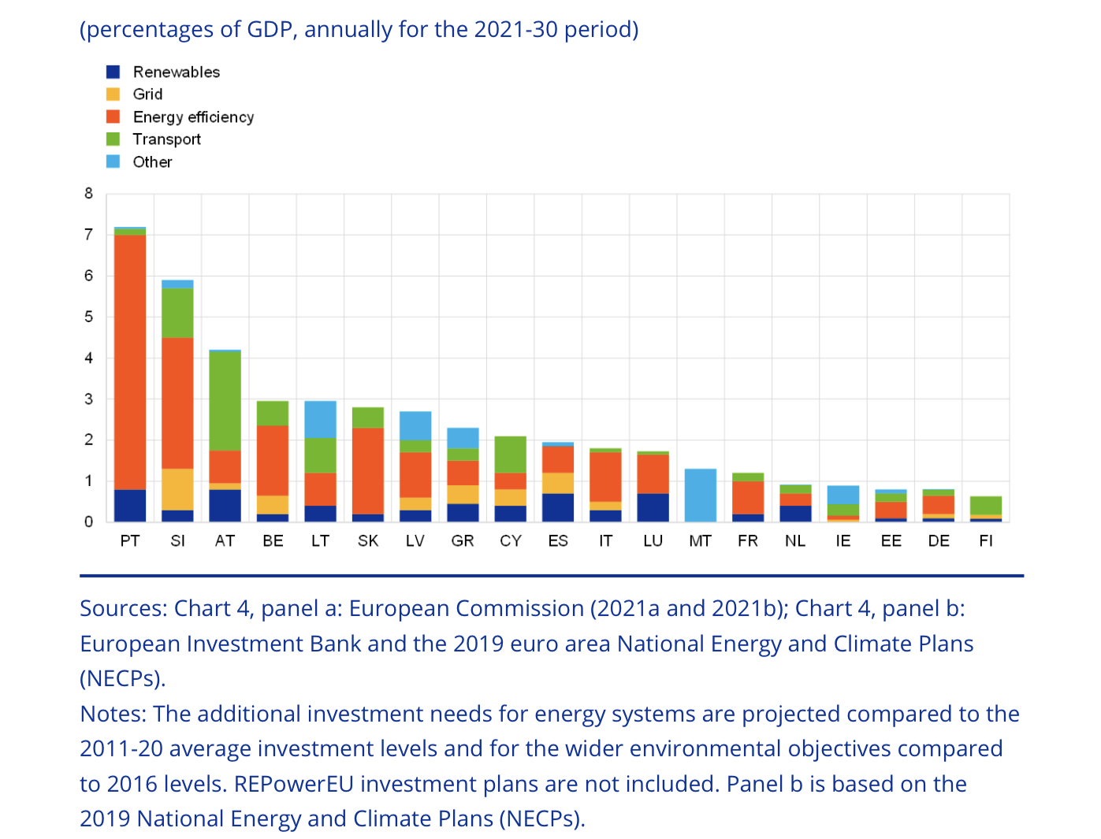
Chart 1: Green investment needs in Euro-area countries

Slide 13
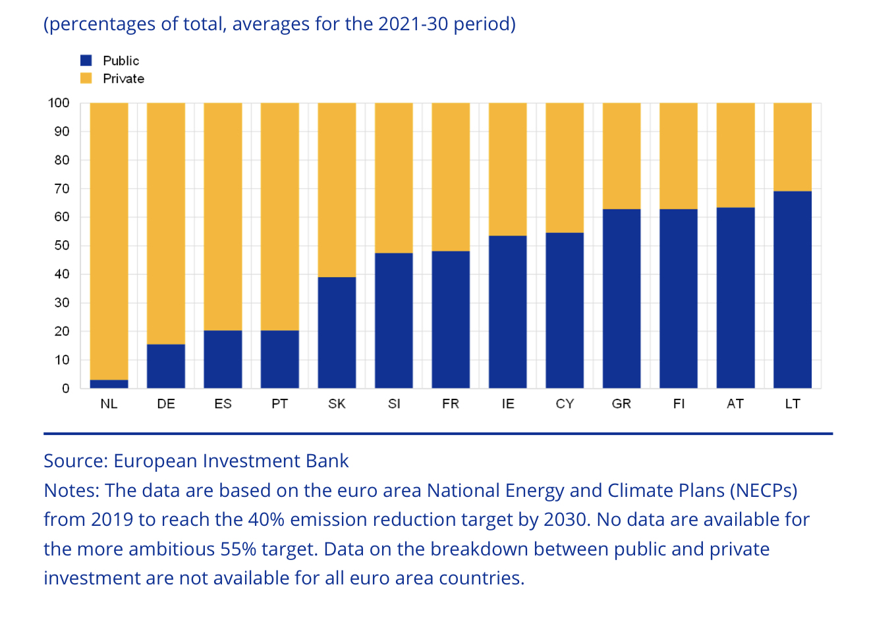
Chart 2: Public and private sources of additional investment needs

Slide 14
Addressing your questions /1:
The public share of the total additional green investment amounts to 45%, i.e. 1,8% of [2019] GDP per year
Rilevant additional investments are also needed for addressing digital transition, age related health and social infrastructures, the ‘strategic compass’, NATO commitments and military and humanitarian assistance and the EU share of the reconstruction bill for Ukraine.
Finally, it’s usually forgotten the additional current expenditure due to additional investment. In medium-term national fiscal projections, additional current expenditure associated with investment financed by NRRP is not included.
Answer: the proposed revisions to the EU fiscal regulations do not provide adequate space for the additional capital and current spending required by EU green and digital objectives and international commitments.

Slide 15
Addressing your questions /2:
Is the economic governance designed to pursue social progress?
The implementation of the European Pillar of Social Rights is among the contents of the National medium-term fiscal-structural plan [page 5], but following fiscal, reform and investment objectives, including those to address macroeconomic imbalances where necessary;
In the European semester [Art 3], is included the formulation, and the surveillance of the implementation, of the employment guidelines that are to be taken into account by Member States in accordance with Article 148(2) TFEU, including the European Pillar of Social Rights, and of the related country-specific recommendations;
‘inclusive growth’ [Whereas (9)] and ‘social and economic resilience’ are inserted [pag 2] in a long list of objectives pursued under the overwhelming objective of putting the public debt on a ‘plausible downward path’. The public debt is the driver: ‘The reform proposals are shaped by the higher and more diverse public debt levels observed over a number of years …’
Given the public debt and deficit binding objectives, the numbers would not add up.

Slide 16
Addressing your questions /2
No surprise: in the TFEU, there is an explicit hierarchy among the objectives: ‘social progress’ or ‘inclusive growth’ or ‘social and economic resilience’ is a byproduct of sound and sustainable government finances set as a means to price stability. ‘Social progress’ [TFEU, Art 3(3)] is pursued if and as long as does not produce ‘prejudice’ to price stability: ‘the primary objective of a single monetary policy and exchange-rate policy shall be to maintain price stability and, without prejudice to this objective, to support the general economic policies in the Union.’ [TFEU, Art 119(2)]. ‘Without prejudice to the objective of price stability, the ESCB shall support the general economic policies in the Union with a view to contributing to the achievement of the objectives of the Union as laid down in Article 3 of the Treaty on European Union.’ [TFEU, Art 127(1)]
The TFEU hierarchy is reproduced in the revised regulation: ‘the Stability and Growth Pact is based on the objective of sound and sustainable government finances as a means of strengthening the conditions for price stability and for strong sustainable growth underpinned by financial stability, thereby supporting the achievement of the Union’s objectives for sustainable and inclusive growth and employment.’ [Whereas (3)]

Slide 17
Addressing your questions /3:
What role does it play for social dialogue?
No changes, no specific and binding provisions:
The involvement of social partners, civil society organisations and other relevant stakeholders in the European Semester is key to ensure ownership and transparent and inclusive policymaking.’ [Whereas (4)];
‘Relevant stakeholders, in particular the social partners, shall be involved within the framework of the European Semester, on the main policy issues where appropriate, in accordance with the provisions of the TFEU and national legal and political arrangements.’ [Art 26: European semester dialogue].

Slide 18
Proposals (inside the box) /1
Golden rule. History:
Existed in Germany [among other OECD countries: UK, J, NZ, etc] from 1969 to 2010. Negative experience: the debt ratio rose from 18% in 1970 to 64% of GDP in 2007, gross government investments shrank from nearly 5% to 2% of GDP.
Shortcomings: no definition of eligible investments; no enforcing mechanism [i.e. compliance with fiscal rules];
Debt sustainability is not improved by whatever ‘golden rule’.

Slide 19
Proposals (inside the box) /2
Golden rule. Conditions:
Defining at EU level, as for the RRPs, eligible projects according to the EU priority areas [green, digital, social, defense, Ukraine];
Additionality [net or gross increase of total investments];
Compliance with the [revised] SGP.
Golden rule. Characteristics:
Exclusion of eligible spending from the speed limit for the Govt expenditure net of discretionary revenues [until 2026, all or a part of the investment programs under the NRRP]
Exclusion of ‘dedicated government investment protection fund’ from the revised fiscal compliance metrics [as proposed by EFB].

Slide 20
Proposals (inside the box) /3
Move the responsibility for proposing the country-specific ‘technical trajectory’ [defined in Art 2(3)] from the Commission to the national government;
Consequently, amend Art 5, 7, 11 and Annex II [replace the word ‘Commission’ with ‘Member State’ in Art 5, delete Art 7 (1)(c) and Art 7(3); …];
As in the proposal, the Commission provides prior guidance [Art 7(a)(b) on the medium-term public debt projection framework and results and its macroeconomic forecast and assumptions;

Slide 21
Proposals (outside the box) /4
EU Central Fiscal Capacity
As stated by EFC, ‘A complete Economic and Monetary Union requires a central fiscal capacity’;
ECB [e.g. Panetta, 30/08/23] underlined the relevance of a safe euro-area asset for a well functioning monetary policy and a CMU;
Financed by euro-bonds [as for RRPs] and EU designated taxes;
Dedicated to the EU’s investment priorities and transnational projects;
Conditional to additionality and compliance with SGP.

Slide 22
Proposals (outside the box) /5
‘Covid public debt’: make “perpetual” the sovereign bonds bought by the ESCB under the PEPP [1,7 €Tn, 12% euro area GDP];
Why not?
The perpetuity does not infringe any formal rule;
No member State lose;
Avoid capital account losses for the ESCB occurring since redemption started [because of interest rate increases];
PEPP financed public debt was ‘good debt’, according to the classification of President Draghi: as stated in the revised regulation, ‘the strong policy response to the COVID-19 pandemic proved highly effective in mitigating the economic and social damage of the crisis’;
Debt sustainability is not improved by whatever’golden rule’.

Slide 23
Conclusion: warning /1
Macroeconomic policy is not a salami: it cannot be sliced for addressing independently its main components [fiscal, monetary, regulatory] as independent parts;
The design of the framework of each component should take explicit account of the basic relations with the other components: e.g.: deflationary monetary policy conflicts with fiscal adjustment and additional public investments [previous panel].

Slide 24
Conclusion: warning /2
Given the principles in the TFEU and the Directives on the 4 liberties (free movements of capital, goods, services and persons), enlargement of the EU and the single market to Ukraine, the Balkans, etc. will deepen tax and social dumping, reduce taxable incomes in the current EU members, shrink fiscal space in the national and EU budget and make still more difficult agreements for advancing political and policy integration, first of all of the fiscal and taxation fields.

